Slide 1
Muhammad Iylia Bin Mohd Hutta
P7474841

Slide 2
Datasets
Resale Flat Prices
HDB Resale Price Index
Number of Applications Registered for Resale Flats
Completion Status for HDB Developments
Bookings for New Flats

Slide 3
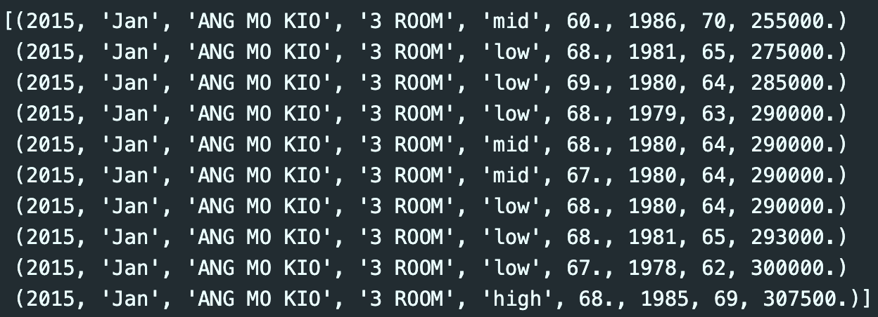
Resale Flat Prices
There are 180380 rows and 8 columns in this dataset
The names of the columns are:
year <class int64>
month <class <U50>
town <class <U50>
flat_type <class <U50>
storey_range <class <U50>
floor_area_sqm <class float64>
lease_commence_date <class int64>
remaining_lease <class int64>
resale_price <class float64>
Data transformation:
The dataset is a combination of data from the ‘2015 to 2016’ and ’2017 to present’ datasets
The ‘storey_range’ column was converted from numbered ranges to categorical levels of ‘low/mid/high’
The initial ‘month’ column obtained from data.gov.sg was split into the ‘year’ and ‘month’ columns

Slide 4
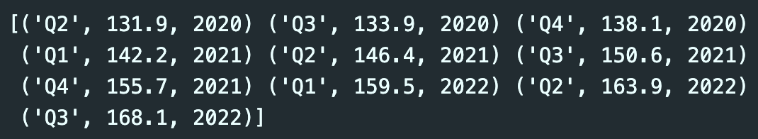
HDB Resale Price Index
There are 131 rows and 3 columns in this dataset
The names of the columns are:
quarter <class <U50>
index <class float64>
year <class int64>
The index calculates the average quarterly resale price while accounting for flat types, towns, and models.
Data transformation:
The initial ‘quarter’ column obtained from data.gov.sg was split into the ‘quarter’ and ‘year’ columns

Slide 5
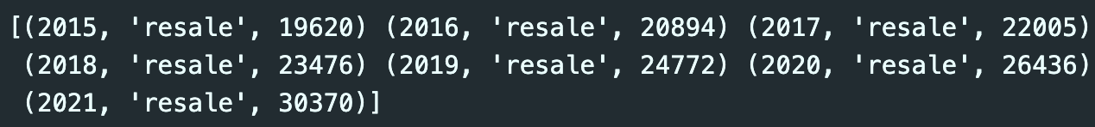
Number of Applications Registered for Resale Flats
There are 7 rows and 3 columns in this dataset
The names of the columns are:
year <class <int64>
type <class <U50>
applications_registered <class int64>
Data transformation:
The dataset was filtered for only resale flats and excluded for rental flats

Slide 6
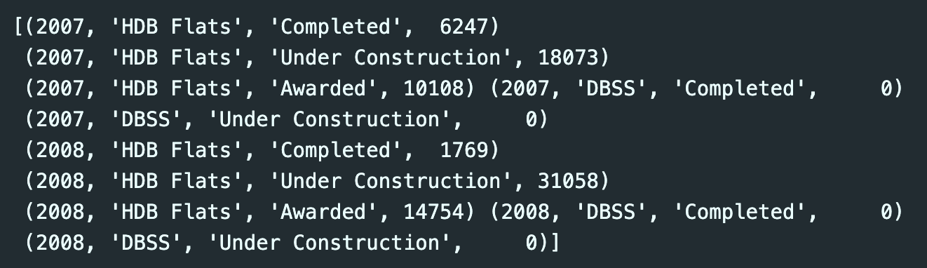
Completion Status of HDB Residential Developments
There are 75 rows and 4 columns in this dataset
The names of the columns are:
year <class int64>
type <class <U50>
status <class <U50>
no_of_units <class int64>
This dataset only includes new flats by HDB (incl. BTO, DBSS)
Data transformation:
The ‘no_of_units’ column had missing values indicated by ‘na’, which were filled with 0 values for ease of analysis

Slide 7
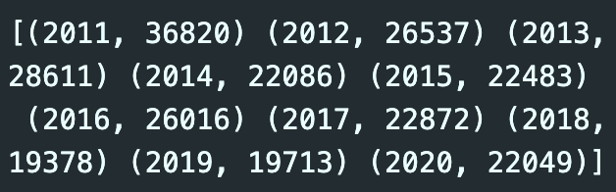
Bookings for New Flats
There are 11 rows and 2 columns in this dataset
The names of the columns are:
year <class <U50>
no_of_units <class int64>
This dataset only includes applications for new flats by HDB (incl. BTO, DBSS)

Slide 8
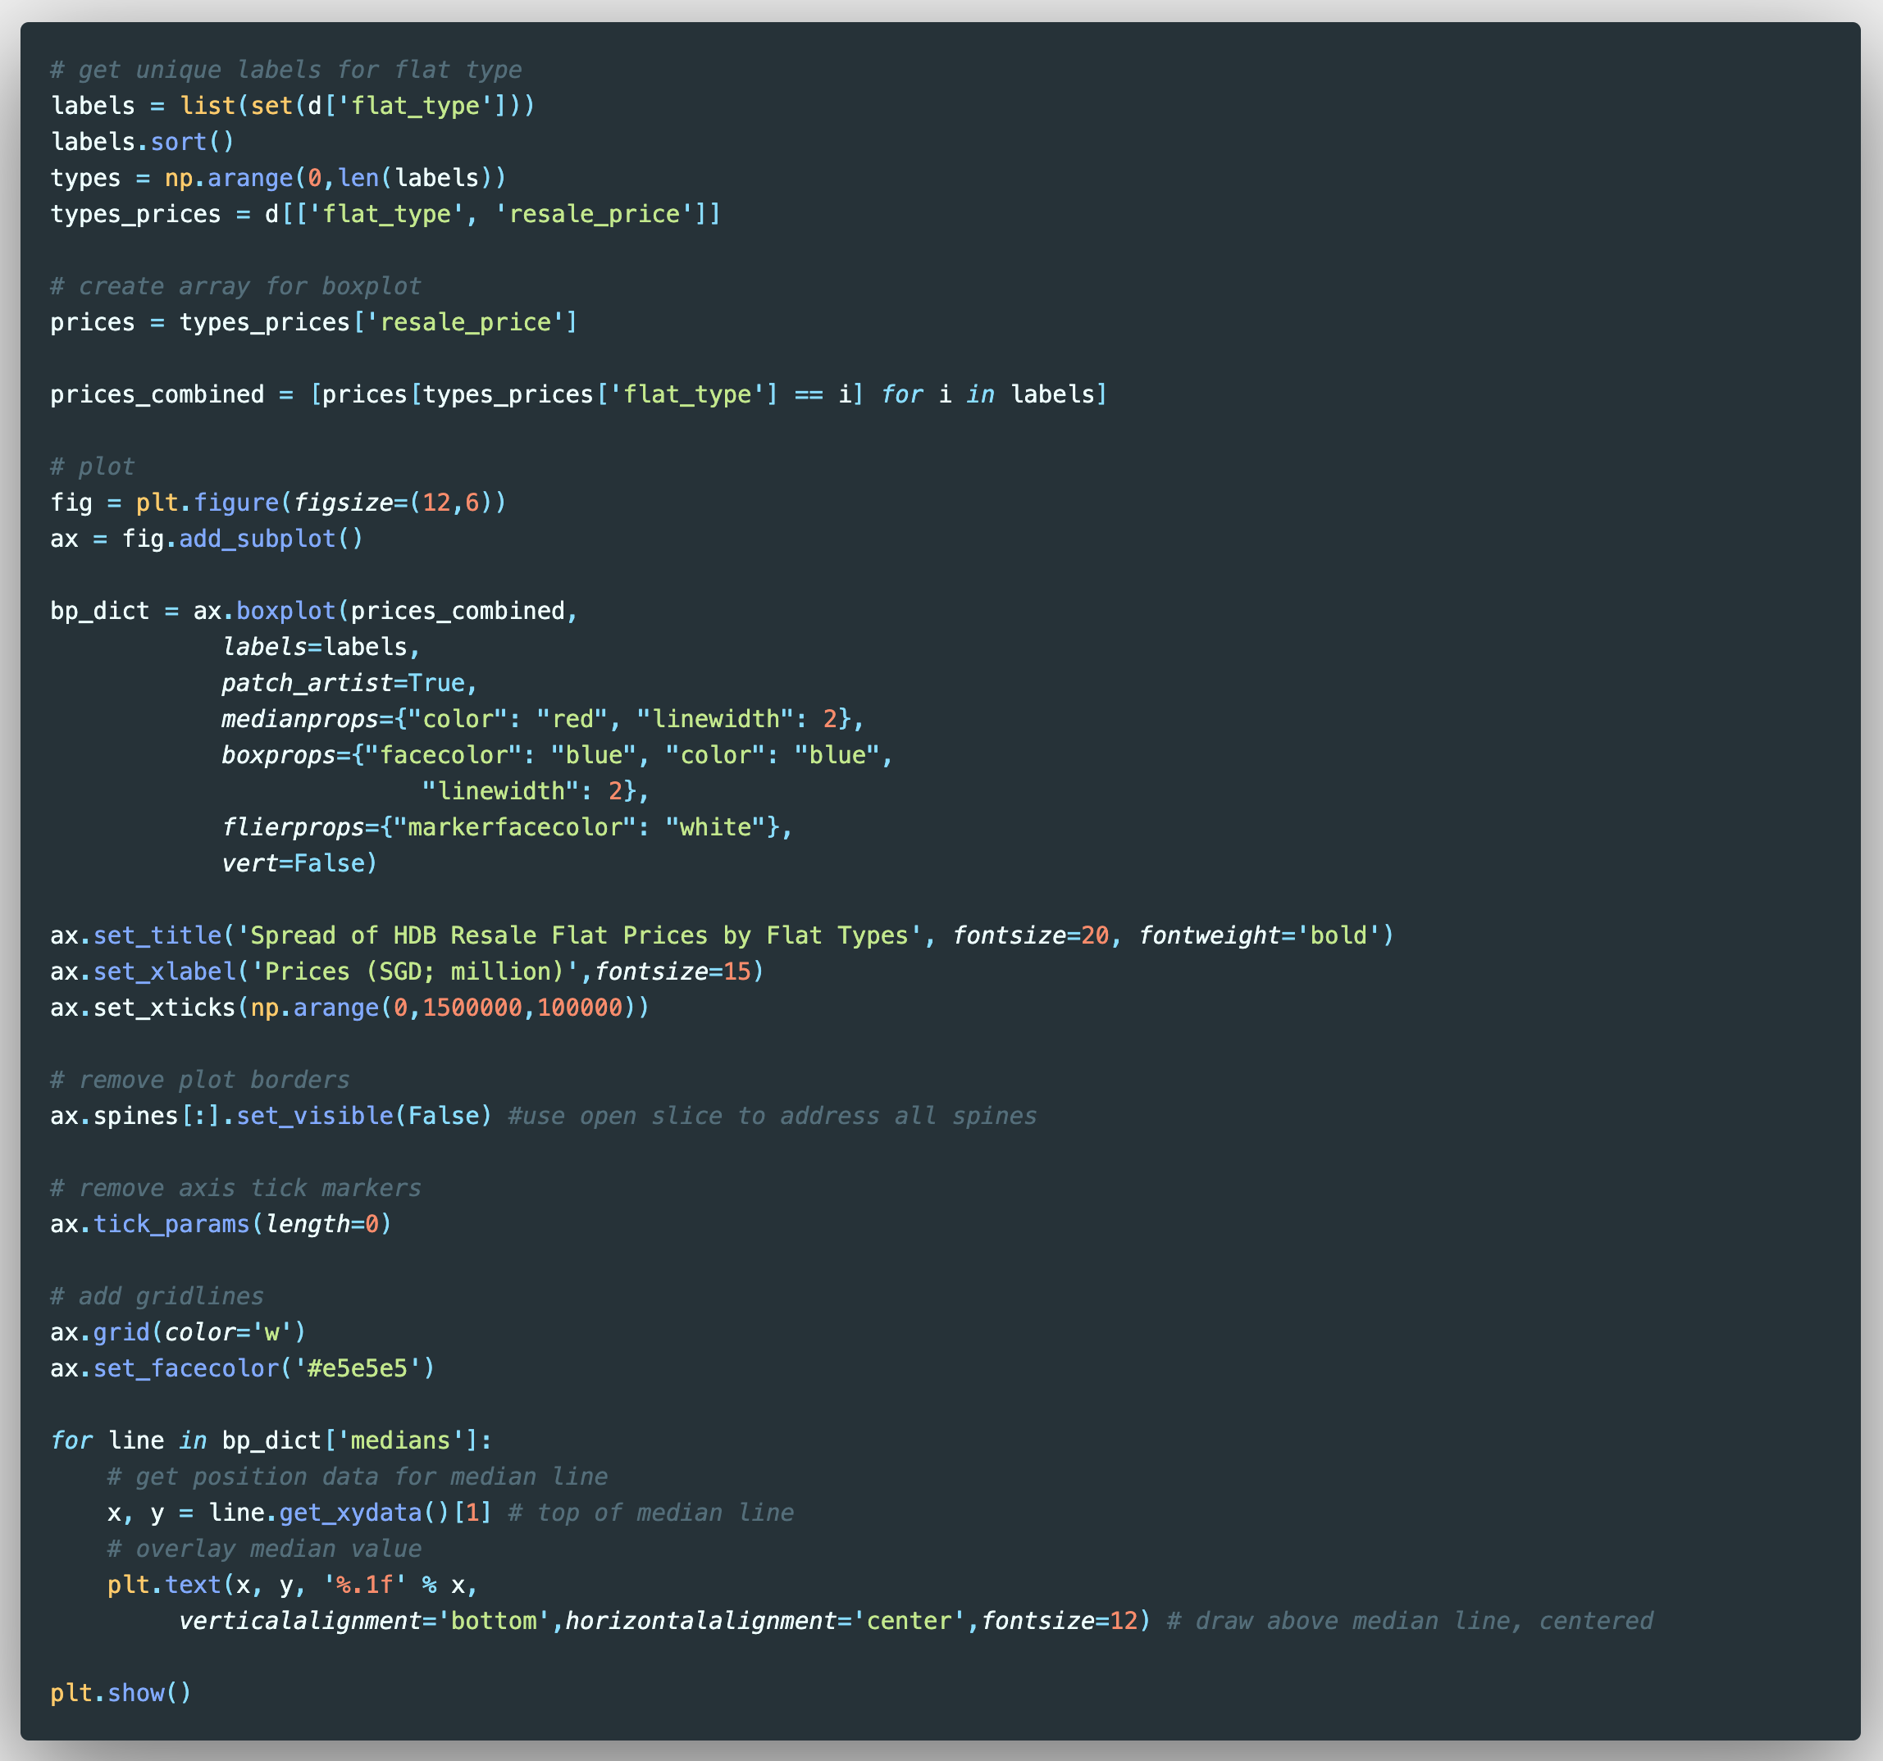
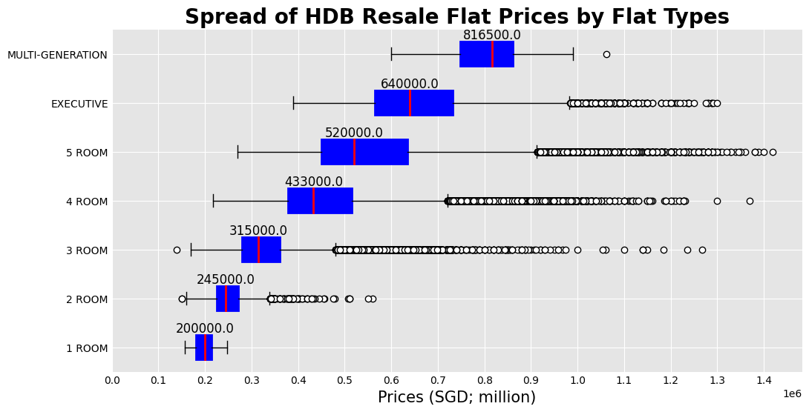
HDB Resale Flat Prices
Two lists were created for the Flat Type labels (‘labels’) and the range of prices for each flat type (‘prices_combined’)
Using the set() function and list comprehension respectively
The lists were used to create a boxplot of the spread of HDB Resale Flat Prices by Flat Types
Design and label attributes were added to the boxplot for better visualisation
Iylia Hutta

Slide 9
HDB Resale Flat Prices
As expected, the larger flat types see higher median prices than those of smaller types
Most flat types prices (except 1-room and Multi-Generation) are right-skewed with many outliers in the higher range of prices
The reason for skewness could be due to recent sales of resale flats hitting the price point of S$1m
Iylia Hutta

Slide 10
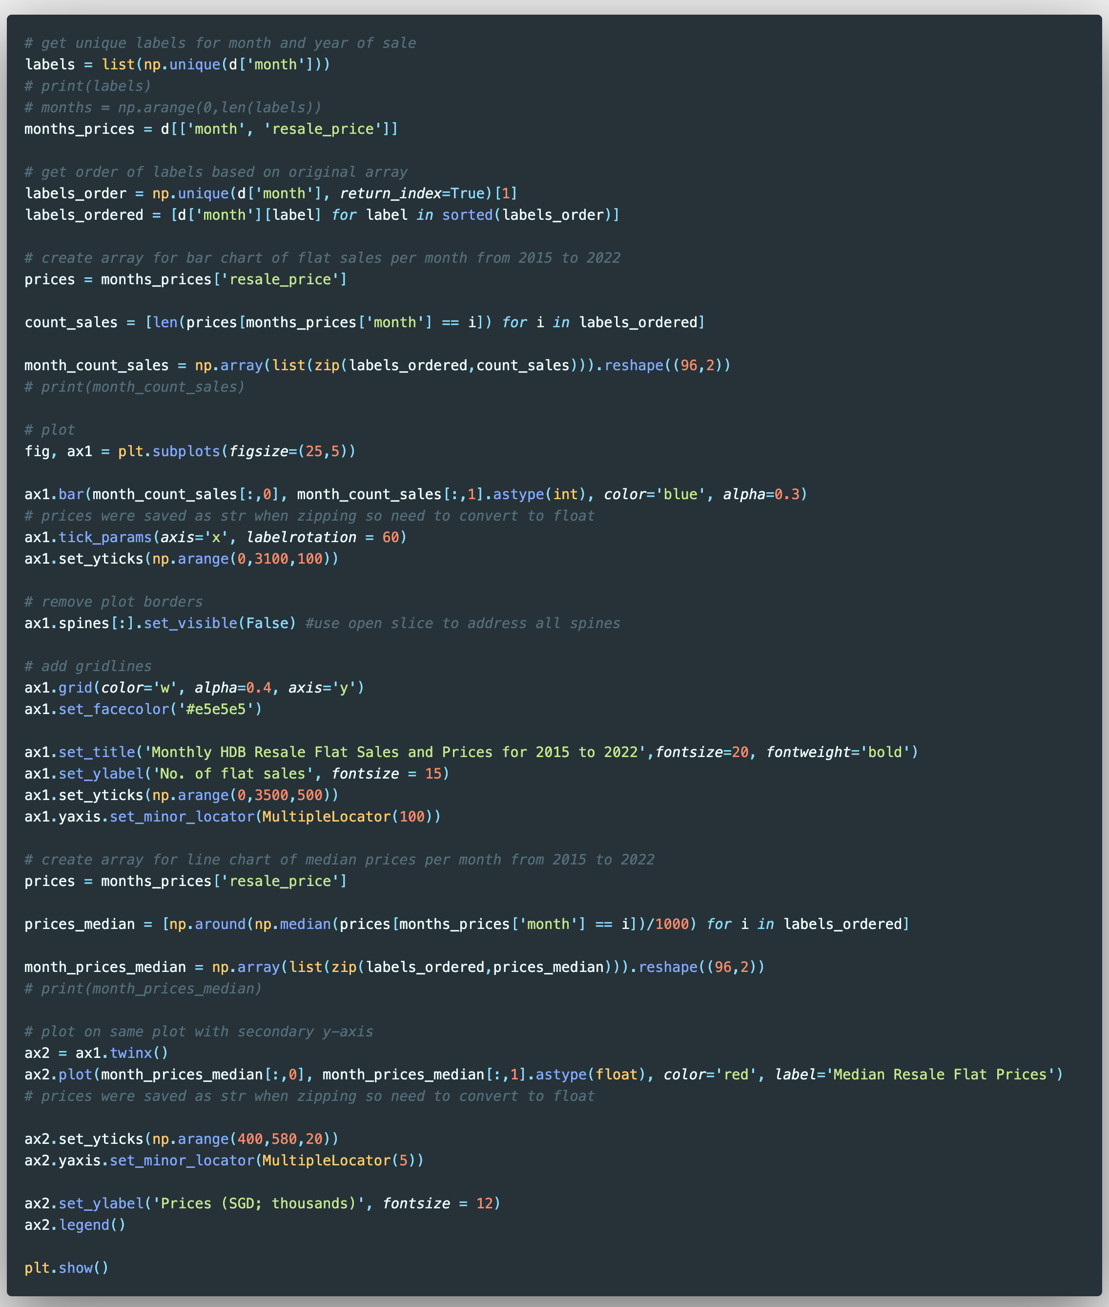
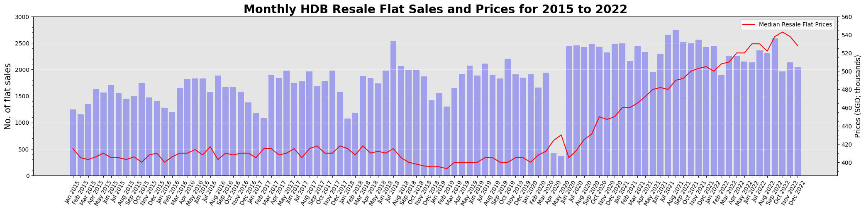
HDB Resale Flat Prices and Sales
List comprehension was used to create lists of the following:
Months and years labels (‘labels_ordered’)
Count of Resale Flat Sales (‘count_sales’)
Median Resale Flat Prices per month (‘prices_median’)
Median was used as the boxplot earlier showed that prices were skewed
Using the zip() function, the labels were combined with the other two lists to create 2D-arrays to create bar (‘month_count_sales’) and line (‘month_prices_median’) plots respectively.
The ax.twinx() function was used to create the line plot overlayed on the bar plot, with secondary y-axis.
A legend was included to indicate which dataset the line plot refers to

Slide 11
HDB Resale Flat Prices and Sales
The time series chart shows that HDB resale flat prices have indeed risen over the past few years, with the largest jump occurring from June 2020 onwards, right after the Circuit Breaker period.
The increase in resale flat prices can be attributed to increased demand as many individuals or couples sought to get a place of their own after experiencing isolation at home during the Circuit Breaker and ensuing phases introduced by the MMTF in managing the pandemic.
Furthermore, the fall in prices seen towards the end of 2021 and 2022 could be attributed to property cooling measures introduced by HDB in December 2021 and October 2022 respectively.

Slide 12
HDB Resale Flat Prices and Sales
We can see that for the Circuit Breaker period, the overall median resale price drop was linked to a large drop in volume of HDB resale flats sold.
Additionally, across 2015 – 2022, most HDB resale flat transactions took place within February - November, with a typical fall in resale flat transactions at the beginning and end of the year.
After the introduction of the two property cooling measures mentioned earlier, resale flat sales volume also saw drops
The recent property cooling measures had the most impact on reducing resale flat sales volumes and prices compared to the ones introduced in December 2021

Slide 13
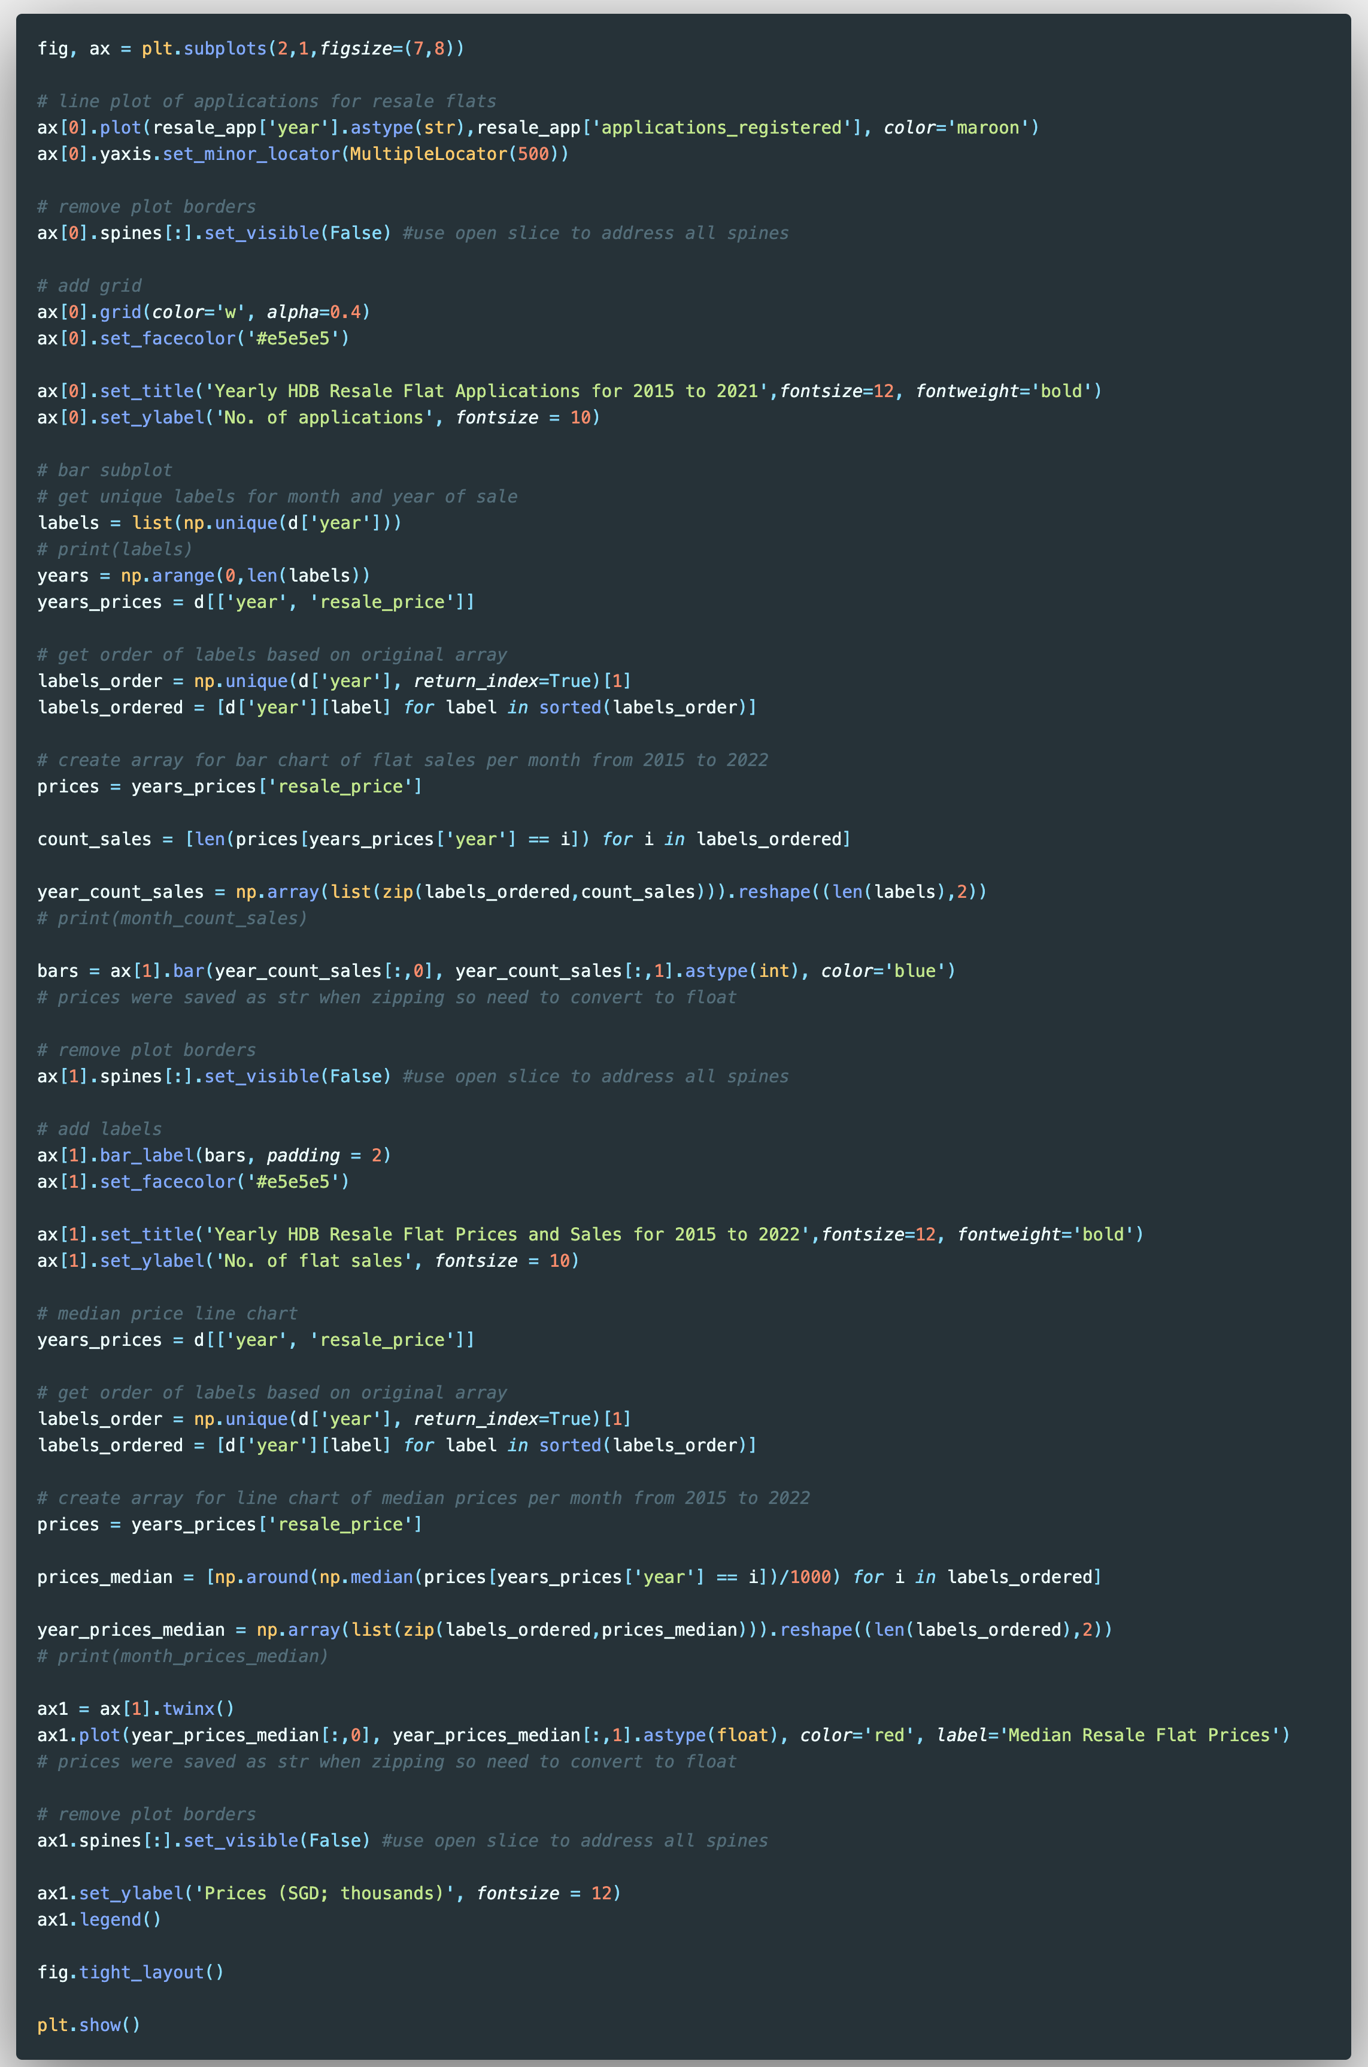
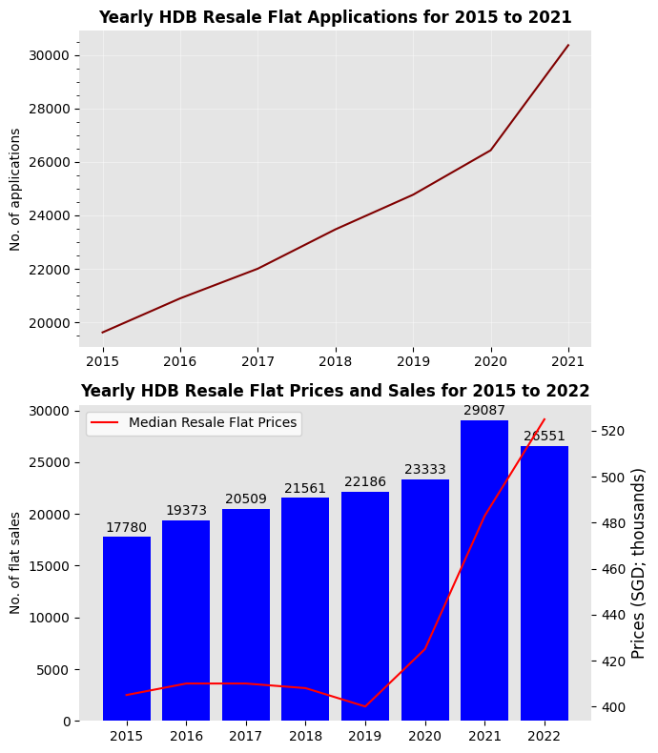
HDB Resale Flat Sales and Applications
adsasda

Slide 14
HDB Resale Flat Sales and Applications

Slide 15
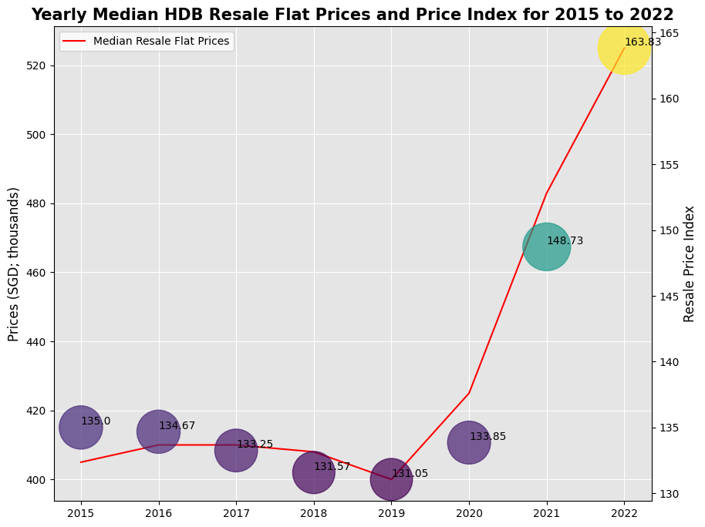

Slide 16
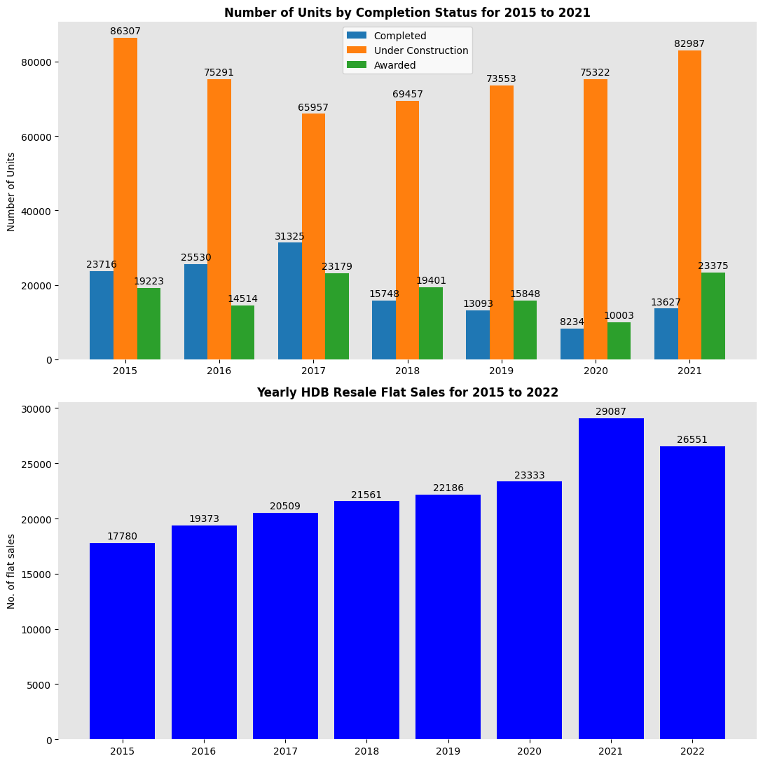

Slide 17
